Slide 1
Parallel and Distributed Computing
Flynn’s Taxonomy

Slide 2
Agenda
A Quick Review
Flynn’s Taxonomy
  SISD
  MISD
  SIMD
  MIMD
Physical Organization of Parallel Platforms
  PRAM
Routing techniques and Costs
Notes:
What and when

Slide 3
Quick Review to the Previous Lecture
Amdahl’s Law of Parallel Speedup
  Purpose, derivation, and examples
Karp-Flatt Metric
  Finding sequential fraction in the given parallel setup
Types of Parallelism
  Data-parallelism
    Same operation on different data elements
  Functional-parallelism
    Different independent tasks with different operations on different data elements can be parallelized
  Pipelining
    Overlapping the instructions in a single instruction cycle to achieve parallelism
Notes:
What and when

Slide 4
Quick Review to the Previous Lecture
Multiprocessor
  Centralized multiprocessor
  Distributed multiprocessor
  Shared address space(NUMA) vs Shared memory(UMA)
Multicomputer
  Asymmetrical
  Symmetrical
Cluster vs Network of Workstations
Assigned Reading
  Cache Coherence and snooping
  Branch prediction and issues while pipelining the problem
Notes:
What and when

Slide 5
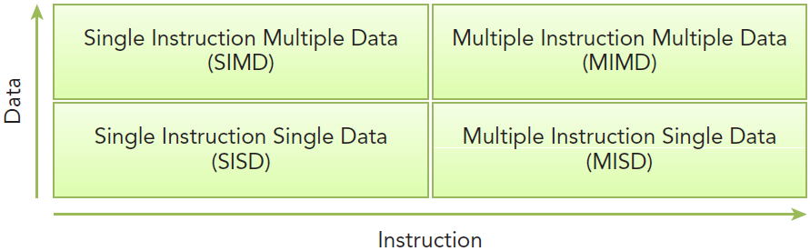
Flynn’s Taxonomy
Widely used architectural classification scheme
Classifies architectures into four types
The classification is based on how data and instructions flow through the cores.

Slide 6
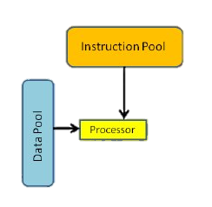
Flynn’s Taxonomy
SISD (Single Instruction Single Data)
Refers to traditional computer: a serial architecture
This architecture includes single core computers
Single instruction stream is in execution at a given time
Similarly, only one data stream is active at any time
Notes:
Not parallel, classical Von Neumann architecture
Parallelism can be introduced using pipelining

Slide 7
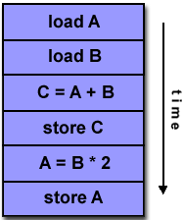
Example of SISD:

Slide 8
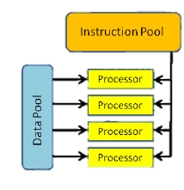
Flynn’s Taxonomy
SIMD (Single Instruction Multiple Data)
Refers to parallel architecture with multiple cores
All the cores execute the same instruction stream at any time but, data stream is different for the each.
Well-suited for the scientific operations requiring large matrix-vector operations
Vector computers (Cray vector processing machine) and Intel co-processing unit ‘MMX’ fall under this category.
Used with array operations, image processing and graphics
Notes:
Array: same operations on different array elements. Replaces the loops
Image: Applying same operation on different pixels

Slide 9
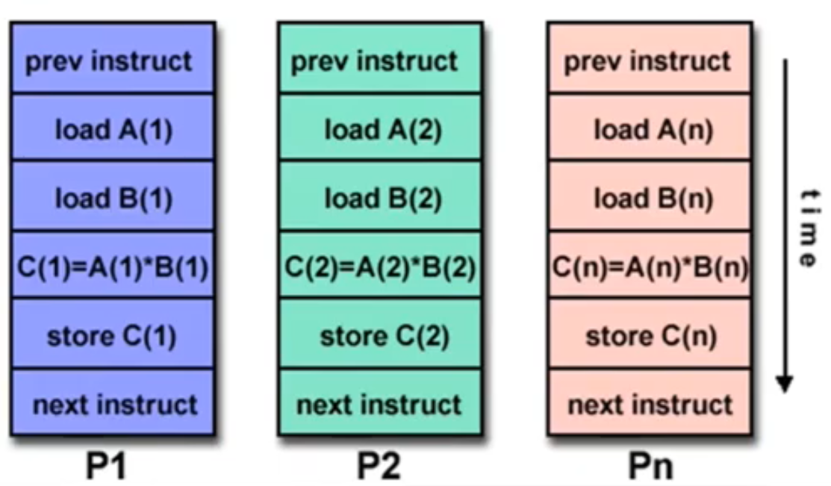
Example of SIMD:

Slide 10
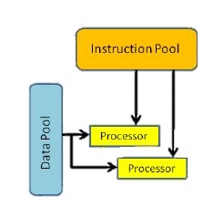
Flynn’s Taxonomy
MISD (Multiple Instructions Single Data)
Multiple instruction stream and single data stream
    A pipeline of multiple independently executing functional units
    Each operating on a single stream of data and forwarding results from one to the next
Rarely used in practice
E.g., Systolic arrays : network of primitive processing elements that pump data.
Notes:
In parallel computer architectures, a systolic array is a homogeneous [similar] network of tightly coupled data processing units called cells or nodes.

Slide 11
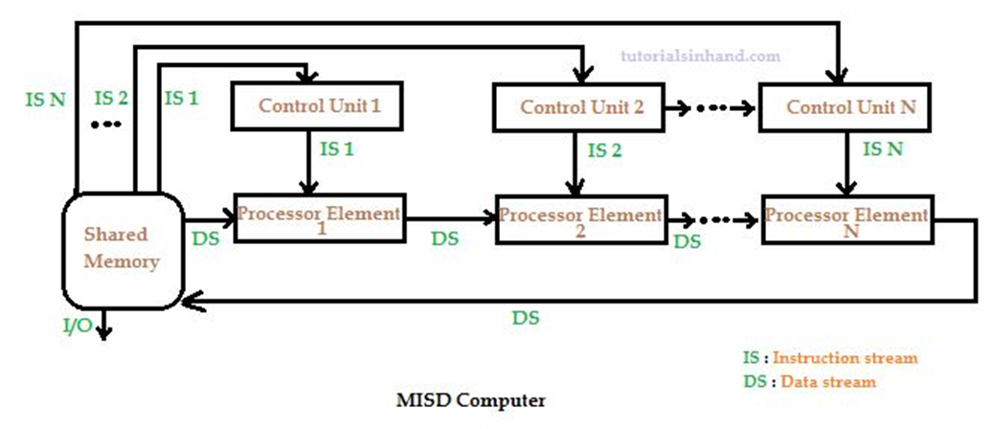
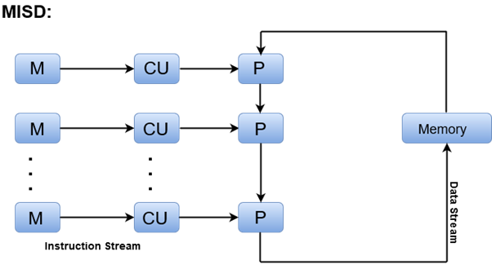
MISD Example

Slide 12
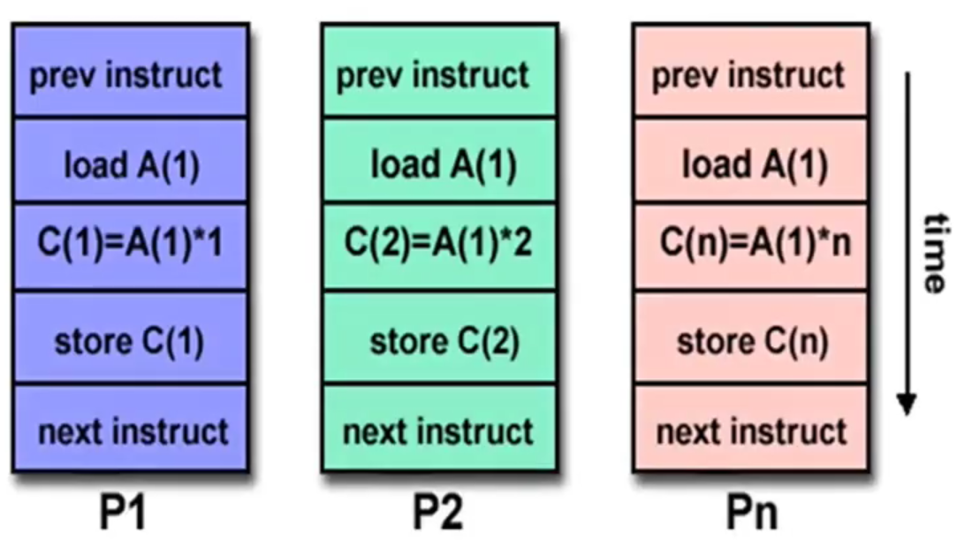
Example of MISD:

Slide 13
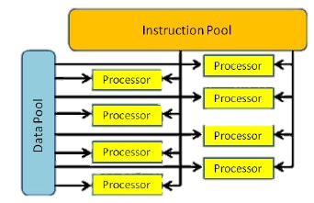
Flynn’s Taxonomy
MIMD (Multiple Instructions Multiple Data)
Multiple instruction streams and multiple data streams
Different CPUs can simultaneously execute different instruction streams manipulating different data
Most of the modern parallel architectures fall under this category e.g., Multiprocessor and multicomputer architectures
Many MIMD architectures include SIMD executions by default.
Notes:
e.g. super computers

Slide 14
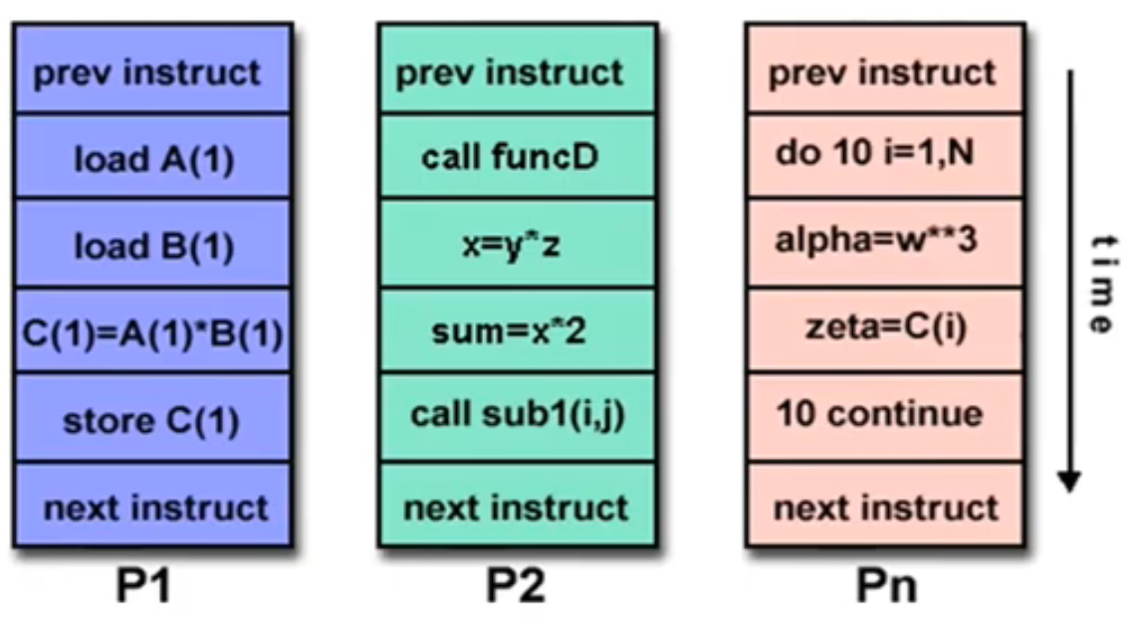
Example of MIMD:

Slide 15
Flynn’s Taxonomy
A typical SIMD architecture (a) and a typical MIMD architecture (b).

Slide 16
SIMD-MIMD Comparison
SIMD computers require less hardware than MIMD computers (single control unit).
However, since SIMD processors ae specially designed, they tend to be expensive and have long design cycles.
Not all applications are naturally suited to SIMD processors.
In contrast, platforms supporting the SPMD (Same Program Multiple Data) paradigm can be built from inexpensive off-the-shelf components with relatively little effort in a short amount of time.
  The Term SPMD is close variant of MIMD
Notes:
Assigned reading: → SPMD(Running same program on multiple computers e.g., clusters of workstations),

Slide 17
Physical Organization of Parallel Platforms

Slide 18
Architecture of an Ideal Parallel Computer
Parallel Random Access Machine (PRAM)
An extension to ideal sequential model: random access machine (RAM)
PRAMs consist of p processors
A global memory
  Unbounded size
  Uniformly accessible to all processors with same address space
Processors share a common clock but may execute different instructions in each cycle.
Based on simultaneous memory access mechanisms, PRAM can further be classified.
Notes:
What is the problem here?
Ans: N no. of processors can perform independent operations on N no. of data in a given time, this might lead to simultaneous access of same memory location by different processors

Slide 19
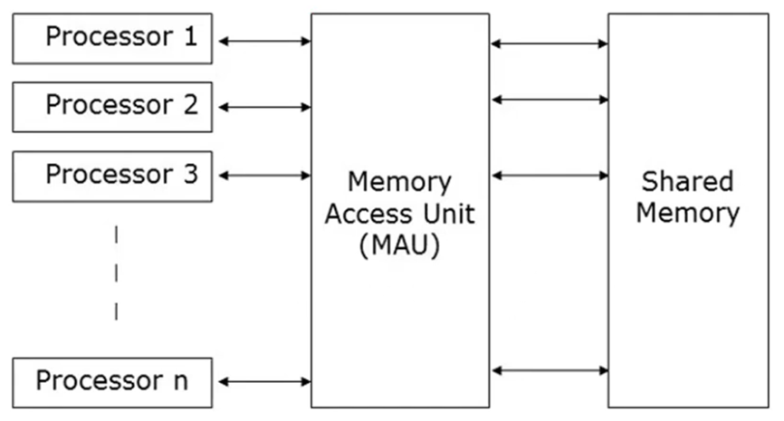
Graphical representation of PRAM:
Notes:
PRAM has a set of similar type of processors
Processors communicate with each other using the shared memory

Slide 20
Architecture of an Ideal Parallel Computer
Parallel Random Access Machine (PRAM)
PRAMs can be divided into four subclasses.
Exclusive-read, exclusive-write (EREW) PRAM
  No two processors can perform read/write operations concurrently
  Weakest PRAM model, provides minimum memory access concurrency
Concurrent-read, exclusive-write (CREW) PRAM
  All processors can read concurrently but can’t write at same time
  Multiple write accesses to a memory location are serialized
Exclusive-read, concurrent-write (ERCW) PRAM
  No two processors can perform read operations concurrently, but can write
Concurrent-read, concurrent-write (CRCW) PRAM
  Most powerful PRAM model
Notes:
To solve the simultaneous access of same memory location problem we have these subclasses
Exclusive meaning: excluding (not doing other things)
Isn’t concurrent write would be an issue?

Slide 21
Architecture of an Ideal Parallel Computer
Parallel Random Access Machine (PRAM)
Concurrent reads do not create any semantic inconsistencies
But, What about concurrent write?
Need of an arbitration(mediation) mechanism to resolve concurrent write access

Slide 22
Architecture of an Ideal Parallel Computer
Parallel Random Access Machine (PRAM)
Mostly used arbitration protocols: -
  Common: write only if all values that the processors are attempting to write are identical
  Arbitrary: write the data from a randomly selected processor and ignore the rest.
  Priority: follow a predetermined priority order. Processor with highest priority succeeds and the rest fail.
  Sum: Write the sum of the data items in all the write requests. The sum-based write conflict resolution model can be extended for any of the associative operators, that is defined for data being written .
Notes:
Max, Multiplication, XOR

Slide 23
Architecture of an Ideal Parallel Computer
Physical Complexity of an Ideal Parallel Computer
Processors and memories are connected via switches.
Since these switches must operate in O(1) time at the level of words, for a system of p processors and m words, the switch complexity is O(mp).
Clearly, for meaningful values of p and m, a true PRAM is not realizable.
Notes:
these switches determine the memory word being accessed by each processor
Switch is a device that opens or closes access to certain data bank or word

Slide 24
Communication Costs in Parallel Machines

Slide 25
Communication Costs in Parallel Machines
Along with idling (doing nothing) and contention (conflict e.g., resource allocation), communication is a major overhead in parallel programs.
The communication cost is usually dependent on a number of features including the following:
  Programming model for communication
  Network topology
  Data handling and routing
  Associated network protocols
Usually, distributed systems suffer from major communication overheads.
Notes:
Programming model for communication—Required pattern of the communication in the program
Associated protocols: Security assessments UDP,TCP,

Slide 26
Message Passing Costs in Parallel Computers
The total time to transfer a message over a network comprises of the following:
  Startup time (t_{s}): Time spent at sending and receiving nodes (preparing the message[adding headers, trailers, and parity information ] , executing the routing algorithm, establishing interface between node and router, etc.).
  Per-hop time (t_{h}): This time is a function of number of hops (steps) and includes factors such as switch latencies, network delays, etc.
    Also known as node latency.
  Per-word transfer time (t_{w}): This time includes all overheads that are determined by the length of the message. This includes bandwidth of links, and buffering overheads, etc.
Notes:
t_{h} also accounts for the latency to take decision of choosing next channel to which this message shall be forwarded
If channel bandwidth is r words/s then each word take t_{w}= 1/r to traverse the link.

Slide 27


Message Passing Costs in Parallel Computers
Store-and-Forward Routing
A message traversing multiple hops is completely received at an intermediate hop before being forwarded to the next hop.
The total communication cost for a message of size m words to traverse l communication links is
In most platforms, t_{h} is small and the above expression can be approximated by
Notes:
Cost of header transfer at each hop (step) t_{h}.
Ts is startup time
Mtw id cost of transferring m words over this link

Slide 28

Message Passing Costs in Parallel Computers
Packet Routing
Store-and-forward makes poor use of communication resources.
Packet routing breaks messages into packets and pipelines them through the network.
Since packets may take different paths, each packet must carry routing information, error checking, sequencing, and other related header information.
The total communication time for packet routing is approximated by:
Here factor t_{w} also accounts for overheads in packet headers.
Notes:
Error checking---parity information
Sequencing---packet order number
Related headers: layers headers, addressing headers

Slide 29
Message Passing Costs in Parallel Computers
Cut-Through Routing
Takes the concept of packet routing to an extreme by further dividing messages into basic units called flits or flow control digits.
Since flits are typically small, the header information must be minimized.
This is done by forcing all flits to take the same path, in sequence.
A tracer message first programs all intermediate routers. All flits then take the same route.
Error checks are performed on the entire message, as opposed to flits.
No sequence numbers are needed.
Notes:
Sequencing information is not needed as all the packets are following same path which ensures in-order delivery

Slide 30
Message Passing Costs in Parallel Computers
Cut-Through Routing
The total communication time for cut-through routing is approximated by:
This is identical to packet routing, however, t_{w} is typically much smaller.
Notes:
Header of the message takes l*t_{h} to reach the destination and entire message arrives in time mt_{w} after the message header

Slide 31
Message Passing Costs in Parallel Computers
(a) through a store-and-forward communication network;
b) and (c) extending the concept to cut-through routing.
Notes:
Shaded regions here represent the time where message is in transit (travel)
The startup time associated with this message transfer is assumed to be zero

Slide 32


Message Passing Costs in Parallel Computers
Simplified Cost Model for Communicating Messages
The cost of communicating a message between two nodes l hops away using cut-through routing is given by
In this expression, t_{h} is typically smaller than t_{s} and t_{w}. For this reason, the second term in the RHS does not show, particularly, when m is large.
For these reasons, we can approximate the cost of message transfer by
Notes:
For communication using flits, start-up time dominates the node latencies.

Slide 33
Message Passing Costs in Parallel Computers
Simplified Cost Model for Communicating Messages
It is important to note that the original expression for communication time is valid for only uncongested networks.
Different communication patterns congest different networks to varying extents.
It is important to understand and account for this in the communication time accordingly.

Slide 34

Questions

Slide 35
References
Flynn, M., “Some Computer Organizations and Their Effectiveness,” IEEE Transactions on Computers, Vol. C-21, No. 9, September 1972.
Kumar, V., Grama, A., Gupta, A., & Karypis, G. (1994). Introduction to parallel computing (Vol. 110). Redwood City, CA: Benjamin/Cummings.
Quinn, M. J. Parallel Programming in C with MPI and OpenMP,(2003).

